Slide 2
Objectives
Identify errors in algorithms and suggest ways to fix the errors
Suggest and apply suitable test data including:
Normal
Abnormal
Extreme (largest/smallest acceptable value)
Boundary (largest/smallest acceptable value and corresponding smallest/largest rejected value)
Be able to complete a trace table for a dry-run of an algorithm including variables, outputs and user prompts

Slide 3
Starter
INPUT Num1 INPUT Num2 INPUT Num3 MaxNum ← 0
IF Num1 >= Num2 AD Num1 >= Num3 THEN MaxNum ← Num3 ELSE IF Num2 >= Num3 THEN MaxNum ← Num2 ELSE MaxNum ← Num3 ENDIF ENDIF OUTPUT "Max number: , maxNum
What are the three mistakes in the code above?

Slide 4
Starter
AND
INPUT Num1 INPUT Num2 INPUT Num3 MaxNum ← 0
IF Num1 >= Num2 AD Num1 >= Num3 THEN MaxNum ← Num3 ELSE IF Num2 >= Num3 THEN MaxNum ← Num2 ELSE MaxNum ← Num3 ENDIF ENDIF OUTPUT "Max number: , maxNum
Num1
"

Slide 5
Syntax errors
A syntax error is one where the code written doesn’t conform to the rules of the language
The compiler doesn’t know how to translate the program into machine code so will give the programmer a syntax error
The program cannot be run until all syntax errors are fixed
Which of the errors in the starter were syntax errors?
INPUT Num1 INPUT Num2 INPUT Num3 MaxNum ← 0
IF Num1 >= Num2 AD Num1 >= Num3 THEN MaxNum ← Num3 ELSE IF Num2 >= Num3 THEN MaxNum = Num2 ELSE MaxNum ← Num3 ENDIF ENDIF OUTPUT "Max number: , maxNum
AND
"
Num1

Slide 6
Syntax errors
There are two syntax errors
This is because they don’t conform to the grammar of the language, so the compiler doesn’t know how to translate them
Notice that MaxNum = Num2 is not a syntax error. It will evaluate to TRUE or FALSE and do nothing with it
INPUT Num1 INPUT Num2 INPUT Num3 MaxNum ← 0
IF Num1 >= Num2 AD Num1 >= Num3 THEN MaxNum ← Num3 ELSE IF Num2 >= Num3 THEN MaxNum = Num2 ELSE MaxNum ← Num3 ENDIF ENDIF OUTPUT "Max number: , maxNum
AND
"

Slide 7
Logical errors
The remaining error is a logical error
The program will run, but it won’t work as the programmer intended
It will give the wrong maximum number if Num1 is greatest
INPUT Num1 INPUT Num2 INPUT Num3 MaxNum ← 0
IF Num1 >= Num2 AD Num1 >= Num3 THEN MaxNum ← Num3 ELSE IF Num2 >= Num3 THEN MaxNum = Num2 ELSE MaxNum ← Num3 ENDIF ENDIF OUTPUT "Max number: , maxNum
Num1

Slide 8
Runtime errors
Look at the following program:
INPUT NumberOfCakes
INPUT NumberOfPeople
cakePerPerson ← NumberOfCakes / NumberOfPeople
OUTPUT cakePerPerson, "cakes per person"
What will the program output if cakes = 10 and people = 2 ?
What will the program output if cakes = 20 and people = 0 ?

Slide 9
Runtime errors
Look at the following program:
INPUT NumberOfCakes
INPUT NumberOfPeople
cakePerPerson ← NumberOfCakes / NumberOfPeople
OUTPUT cakePerPerson, "cakes per person"
What will the program output if cakes = 10 and people = 2 ? Output: 5.0 cakes per person
What will the program output if cakes = 20 and people = 0 ? Output: ZeroDivisionError: division by zero

Slide 10
Runtime errors
The program outputs a “ZeroDivisionError”
This is because you cannot divide a number by zero
This is a runtime error as it will only happen when the program is running
There is nothing wrong with the syntax or logic of the program

Slide 11
Worksheet 6
Complete Task 1 on Worksheet 6

Slide 12
Testing
It is important that programs are fully tested to find any errors that may occur
Before testing, a test plan is created which will test for:
Normal data
Abnormal data
Extreme data
Boundary data
What do you think each of these types of test mean?

Slide 13
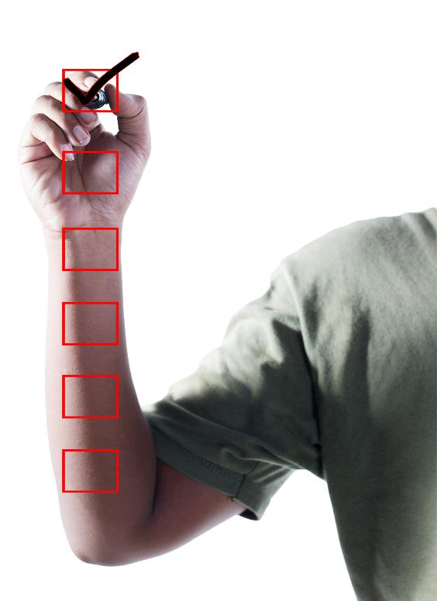

Test data
Suppose the user is asked to enter a number between 1 and 100
What test data would you use to test your program?

Slide 14
Tests
Program: enter a number between 1 and 100
Some examples of test data:
Normal data: 5 (checks a single digit), 14 (checks two digits)
Boundary data: 1 and 0 (checks either side of the lower boundary), 100 and 101 (checks either side of the higher boundary)
Extreme data: 1 and 100 (the smallest and highest acceptable values)
Abnormal: -50 (checks negative numbers), 173 (checks data of the correct type that is invalid) – abnormal data is data that falls outside of what is acceptable

Slide 15
Finding logic errors
A trace table is useful for tracing through a program in order to find logic errors
The value of each variable is recorded as it changes
Another useful technique when programming is to insert OUTPUT statements at various points in the program to check the values of variables

Slide 16
Using a trace table
Trace tables are used to perform a dry-run of a program on paper
The value of each variable is recorded as it changes
What value is output in the code below?
Num ← 3
N ← 0
WHILE N < 4 DO
Num ← Num + N
N ← N + 1
OUTPUT Num
Num | N | N < 4 | OUTPUT
3 | 0 | TRUE

Slide 17
Using a trace table
Trace tables are used to perform a dry-run of a program on paper
The value of each variable is recorded as it changes
What value is output in the code below?
Num ← 3
N ← 0
WHILE N < 4 DO
Num ← Num + N
N ← N + 1
OUTPUT Num
Num | N | N < 4 | OUTPUT
3 | 0 | TRUE
3 | 1 | TRUE

Slide 18
Using a trace table
Trace tables are used to perform a dry-run of a program on paper
The value of each variable is recorded as it changes
What value is output in the code below?
Num ← 3
N ← 0
WHILE N < 4 DO
Num ← Num + N
N ← N + 1
OUTPUT Num
Num | N | N < 4 | OUTPUT
3 | 0 | TRUE
3 | 1 | TRUE
4 | 2 | TRUE

Slide 19
Using a trace table
Trace tables are used to perform a dry-run of a program on paper
The value of each variable is recorded as it changes
What value is output in the code below?
Num ← 3
N ← 0
WHILE N < 4 DO
Num ← Num + N
N ← N + 1
OUTPUT Num
Num | N | N < 4 | OUTPUT
3 | 0 | TRUE
3 | 1 | TRUE
4 | 2 | TRUE
6 | 3 | TRUE

Slide 20
Using a trace table
Trace tables are used to perform a dry-run of a program on paper
The value of each variable is recorded as it changes
What value is output in the code below?
Num ← 3
N ← 0
WHILE N < 4 DO
Num ← Num + N
N ← N + 1
OUTPUT Num
Num | N | N < 4 | OUTPUT
3 | 0 | TRUE
3 | 1 | TRUE
4 | 2 | TRUE
6 | 3 | TRUE
9 | 4 | FALSE | 9

Slide 21
Determine the function of an algorithm
Complete the trace table for the algorithm and state its function:
Assume the user enters values 8, 3, 6, 5, 10, 6
Total ← 0
FOR i ← 1 TO 4
INPUT Base
INPUT height
x ← (Base * Height)/2
Total ← Total + x
Result ← Total / 3
OUTPUT Result
Total | i | Base | Height | x | Output
0 | 1 | 8 | 3 | 12

Slide 22
Determine the function of an algorithm
Complete the trace table for the algorithm and state its function:
Assume the user enters values 8, 3, 6, 5, 10, 6
Total ← 0
FOR i ← 1 TO 4
INPUT Base
INPUT height
x ← (Base * Height)/2
Total ← Total + x
Result ← Total / 3
OUTPUT Result
Total | i | Base | Height | x | Output
0 | 1 | 8 | 3 | 12
12 | 2 | 6 | 5 | 15

Slide 23
Determine the function of an algorithm
Complete the trace table for the algorithm and state its function:
Assume the user enters values 8, 3, 6, 5, 10, 6
Total ← 0
FOR i ← 1 TO 4
INPUT Base
INPUT height
x ← (Base * Height)/2
Total ← Total + x
Result ← Total / 3
OUTPUT Result
Total | i | Base | Height | x | Output
0 | 1 | 8 | 3 | 12
12 | 2 | 6 | 5 | 15
27 | 3 | 10 | 6 | 30

Slide 24
Determine the function of an algorithm
Complete the trace table for the algorithm and state its function:
Assume the user enters values 8, 3, 6, 5, 10, 6
Total ← 0
FOR i ← 1 TO 4
INPUT Base
INPUT height
x ← (Base * Height)/2
Total ← Total + x
Result ← Total / 3
OUTPUT Result
Total | i | Base | Height | x | Output
0 | 1 | 8 | 3 | 12
12 | 2 | 6 | 5 | 15
27 | 3 | 10 | 6 | 30
57 | 4 |  |  |  | 19

Slide 25
Worksheet 6
Complete Task 2 and Task 3 on Worksheet 6

Slide 26
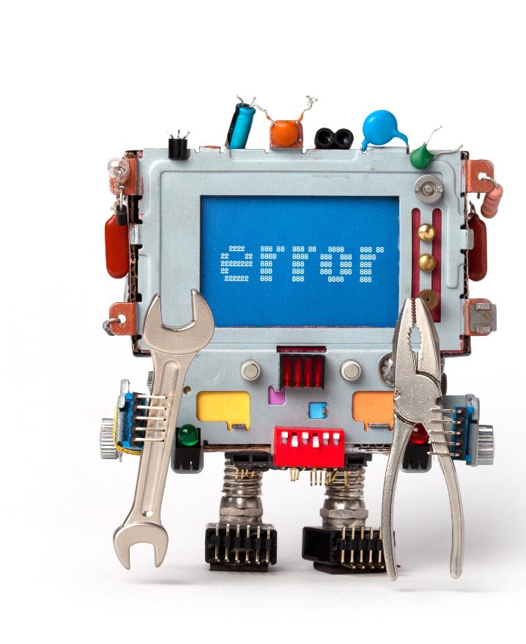
Plenary
In a pair, answer the following questions
State three types of error that can occur
Describe how a trace table works and helps in finding errors in an algorithm or program code

Slide 27
Plenary
State three types of error that can occur
Syntax error, logical error, runtime error
Describe how a trace table works and helps in finding errors in an algorithm or program code
A row in a table represents each iteration of the algorithm
A dry-run of each step of the algorithm is carried out by hand
Variables, outputs and user prompts are all written down

